Slide 1
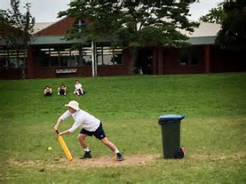
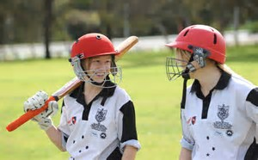
CRICKET IN SECONDARY EDUCATION:

Slide 2
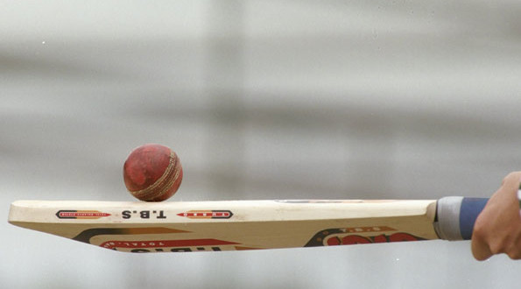
UNIT OF WORK:
Unit of work: the game of cricket.
Numbers of lessons planned: 5
Educational stage: beginners.
Subject area: P.E. in a bilingual setting.
Target grade: first grade.

Slide 3
SCHEME OF WORK:
1. Learning objective: understand why students do things in P.E. (the game of cricket)
2. Sucess criteria: we establish the success criteria based on the following key questions:
How much do the students understand about the content?
- Understanding the unit of work.
How do the students feel during the P. E. lesson?
- Enjoying doing P.E. in a high school setting.
What do they should learn at the end of the lesson?
- Learning strategies, specific contents and language applied to the content.
3. Type of activities: new acquisition of contents, reinforce, revision,... etc.
4. Methodology: C.L.I.L.

Slide 4

CLIL METHODOLOGY:

Slide 5

C.L.I.L. METHODOLOGY:
-GLOBAL STATEMENT: all teachers are teachers of language.
-It is the subject matter which determines the language needed to learn.
-A CLIL lesson looks at the content and language in equal measure.
-A successful CLIL lesson should combine elements of the following:
Content, communication, cognition and culture.

Slide 6

BENEFITS OF USING CLIL METHODOLOGY IN A CLASSROOM:
Why are we using CLIL methodology in the classroom? What are its benefits?
- Cultural awareness.
- Internationalization.
- Language competence.
-Preparation for both life and study.
- Increase motivation.

Slide 7

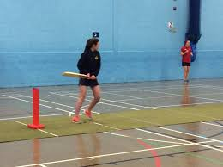
UNIT OF WORK: THE GAME OF CRICKET

Slide 8
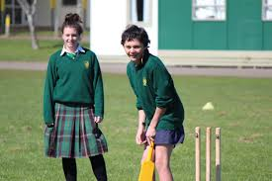
UNIT OF WORK: THE GAME OF CRICKET
Contents:
Lesson 1: (focusing on this lesson on this project):
The development of the bowling accuracy.
Lesson 2: the development of the batting accuracy and the directional batting.
Lesson 3: the close and deep field catching.
Lesson 4: the development of a variety of fielding techniques.
Lesson 5: The game of cricket in real situations. Revision of vocabulary learnt during this unit.

Slide 9
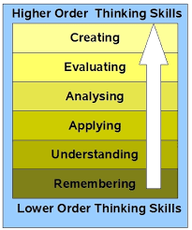
PLANNING ONE LESSON:

Slide 10
LESSON 1: THE DEVELOPMENT OF THE BOWLING ACCURACY:
-ACTIVITY ONE: learning new vocabulary related to the content of the unit of work.
-Development: vocabulary acquisition: how to use a dictionary.
1. You are going to look up words connected to the word cricket by using an online dictionary.
Step 1: Go to Macmillan Dictionary and Thesaurus.
Step 2 : type in the word cricket.
Step 3: Explore the webpage:
Listen to the pronunciation.
Click on word forms.
Read the definitions.
Read the phrases of the word cricket.
Click on Thesaurus for the definition of the sport cricket.
Step 4: study the words on the Thesaurus page.
Questionning (Bloom's Taxonomy): What do you know about the game of the cricket? Could you say at least 3 concrete words related to cricket?
Low level thinking skills: knowledge.

Slide 11
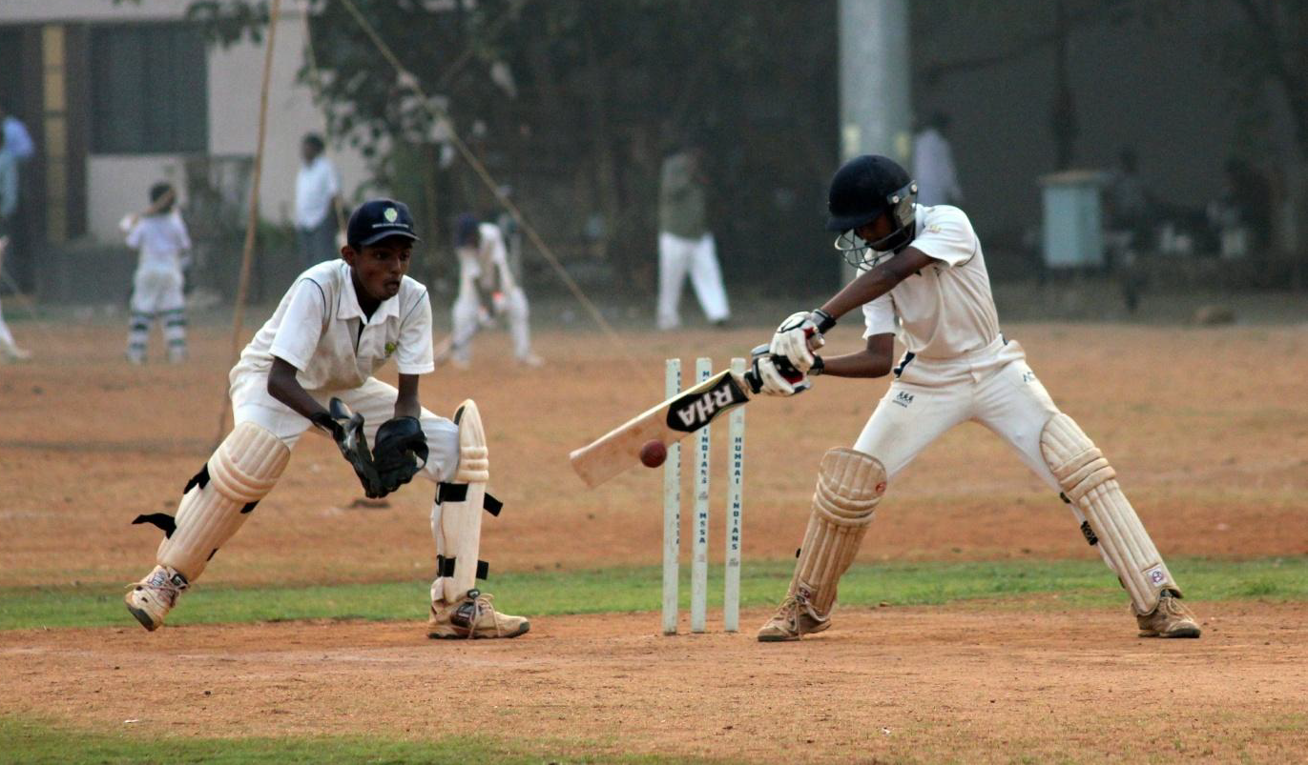
-ACTIVITY TWO: applying new vocabulary learnt in the previous act.
-Development: labelling a picture (Cricket fielders players)
Students will apply the new contents learnt previously using a visual image of a cricket player and filling up gaps. Students are working in groups of 2 or 3.
Questionning (Bloom's Taxonomy): Can you list at least three main equipments used in Cricket? What can you say about the positions of both players?
Low level thinking skills ( Comprenhension )

Slide 12
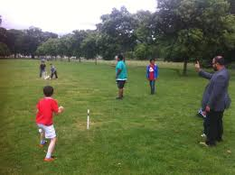
-ACTIVITY THREE: bowl a tennis ball underarm and in an straight direction.
​-Development:
1. Pupils will get into small groups and take turns to bowl towards a target and then some cones.
If the ball goes between the cones after one bounce, they score one.
If the ball hits the ground target and goes into the cones, then they score 3 points.
Extend this by including two targets and the opposite team has to state what target the team has to aim for.
- Questionning( Bloom's Taxonomy): what would result if you throw the ball from different positions? What position would you use to throw the ball further?
-Low level thinking skills: application.

Slide 13
-ACTIVITY FOUR: continuous cricket.
​
​-Development: ​
The ball is bowled towards the batter who attempts to catch it and throws it out towards the field.
The batter has to run whether they catch it or not, and have to get around a cone and back to wicket before the bowler bowls again.
If they are not back, they can be out by the bowler hitting the stumps.
Rotate batters after 4 balls.
Extend this game to include batters
- Questionning (Bloom's Taxonomy): what would result if you throw or battle the ball from different positions? What position would you use to battle the ball further?
-Low level thinking skills: application.
​

Slide 14

CONCLUSIONS:

Slide 15

CONCLUSIONS:
We can point out as conclusions the followings ones:
- three fundamental aspects should be take into account
Through clil methodology:
1. Language awareness.
2. functional competence and cognition.
3. Language proficiency.
-The best teaching styles that better fit to clil methodology are:
-guided discovery.
-troubleshooting.
-creativity and autonomy.

Slide 16


