Slide 1
Key Stage 3
Shot Putt
Chin, Knee and Toe line
Self and Peer Evaluation
Is the performer... Are you...
Creating a strong Chin, Knee, Toe position?
Holding the shot with fingers (not the palm)?
Using all the power from their legs?
Is the shot released at its highest point?
What can they do to be even better?
.......................................................................
.......................................................................
Level | Result
County | 11.20m
Gold | 8.60m
Silver | 6.50m
Bronze | 4.80m
Preparation….Execution….Follow-through

Slide 2
Javelin
Choose Your Grip
Self and Peer Evaluation
Is the performer... Are you...
Holding the javelin securely?
Are the arms straight before throwing?
Is the throw followed through?
Creating a strong Chin, Knee, Toe position?
What can they do to be even better?
.......................................................................
.......................................................................
Level | Result
County | 39m
Gold | 26m
Silver | 19m
Bronze | 12m
Collecting the Javelin...
Approach slowly and carefully.
Hold Up-right
Take your time
70% of your distance comes from here
Recommended Starting Grip

Slide 3
Long Jump
Self and Peer Evaluation
Is the performer... Are you...
Using the arms to aid flight?
Driving their knee up to gain distance?
Using all the power from their legs?
Are they landing as far forward as possible?
What can they do to get better?
.......................................................................
.......................................................................
Level | Result
County | 5.45m
Gold | 4.40m
Silver | 3.80m
Bronze | 2.90m
Take an odd (11 / 13) number of steps away from the board
Use your arms to drive your self further
Plant your strongest foot
Land as far forward as possible

Slide 4
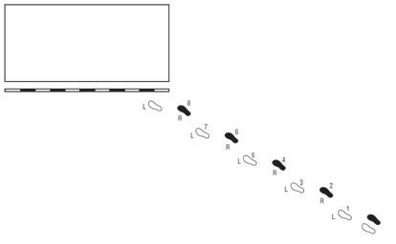
High Jump
Self and Peer Evaluation
Is the performer... Are you...
Approaching the bed at a curved angle?
Using all the power from their legs?
Using their arms to aid hieght?
?Arching over the bar?
What can they do to get better?
......................................................................
.......................................................................
Level | Result
County | 1.60m
Gold | 1.40m
Silver | 1.22m
Bronze | 1.00m
Approach the bed at an angle...
Right foot? From Left
Left Foot? From Right

Slide 5
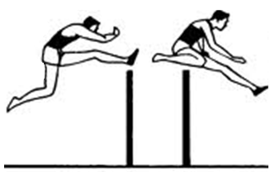
Hurdles
Check out this athletes legs
Self and Peer Evaluation
Is the performer... Are you...
Maintaining a strong running technique?
Using their arm to reach and pull?
Trail Leg
What can be done to improve?
......................................................................................................
Is the performers head staying level?
Lead Leg

Slide 6
Sprinting
Arms going cheek to cheek / ear to pocket?
Standing Up Tall?
Has the head moved during the whole running motion?
Knees driving high?
Reaching far forward with the feet?
Your Sprint Start... A slow deliberate get up from the starting position...

