Slide 1
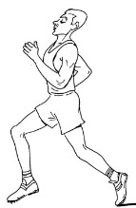
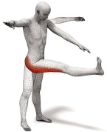
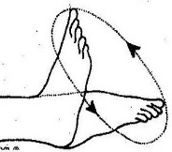
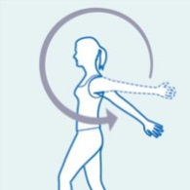
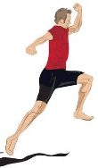

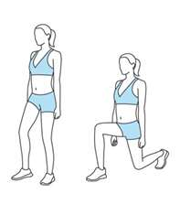
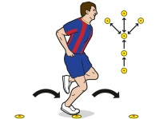
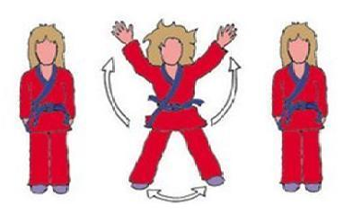
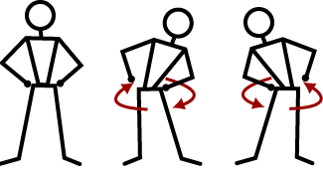
Warm up 1
Warm up 2
1. Jogging
2. Ankle Twirls
3. High Knee
Skipping
4. Lunges on
the spot
5. Star jumps
6. High Kicks
7. Arm Circles
8. Heel Flicks on
the spot
9. Hopping
10. Hip Circles
1. Ankle Twirls
2. High Knee
Skipping
3. Lunges on
the spot
4. Star Jumps
5. High Kicks
6. Arm Circles
7. Heel flicks on
the spot
8. Hopping
9. Hip Circles
10. Jogging

Slide 2
Inset School Logo
Inset School Logo
Warm up 3
Warm up 4
1. High Knee
Skipping
2. Lunges on
the spot
3. Star Jumps
4. High Kicks
5. Arm Circles
6. Heel flicks on
the spot
7. Hopping
8. Hip Circles
9. Jogging
10. Ankle Twirls
1. Lunges on
the spot
2. Star Jumps
3. High Kicks
4. Arm Circles
5. Heel flicks on
the spot
6. Hopping
7. Hip Circles
8. Jogging
9. Ankle Twirls
10. High Knee
Skipping

Slide 3
Inset School Logo
Inset School Logo
Warm up 5
Warm up 6
1. Star jumps
2. High Kicks
3. Arm Circles
4. Heel flicks on
the spot
5. Hopping
6. Hip Circles
7. Jogging
8. Ankle Twirls
9. High Knee
skipping
10. Lunges on
the Spot
1. High Kicks
2. Arm Circles
3. Heel flicks
on the spot
4. Hopping
5. Hip Circles
6. Jogging
7. Ankle Twirls
8. High Knee
Skipping
9. Lunges on the spot
10. Star Jumps

